Slide 1
Data Glacier
Data Science Internship (LISUM01)
G2M Cab Investment Project
Muadh Faizan

Slide 2

Introduction
An investment firm wanted to invest in the cab industry, which comprised of two taxi companies. They needed a study to be conducted, in order to analyse and find out which of the companies would be the more profitable investment.
4 datasets were provided:
Transaction data from 2016 to 2018 with details of trip fare, date of trip, city etc.
Customer ID and corresponding age, gender and income of customer.
Transaction ID with the corresponding customer ID for each transaction.
City data with some population data of each city.

Slide 3
Structure of Project
The project was divided into 4 parts:
Understanding the structure of datasets.
Data processing and merging of datasets.
Exploratory Data Analysis
Findings and Recommendations
The datasets were merged into one master dataset, apart from the city dataset, as I did not use it in the analysis.
One additional dataset was imported from Kaggle, which was the US Weather Data which provided some information on the weather each day. This was also merged into the master dataset.

Slide 4
Assumptions
Some assumptions were made during the project:
The difference between columns 'cost' and 'charged' is the profit per transaction.
Some transactions had negative profit, so I assumed that the customer would have availed some sort of discount or coupon, which reduced the charged amount.
The weather data did not have records for certain days, I assumed that the weather was normal on these days, as there was no 'normal' value in the weather column.
On days where multiple types of weather was present, I only took the first value that occurred. I could not perform better filtration processes due to time constraints.

Slide 5
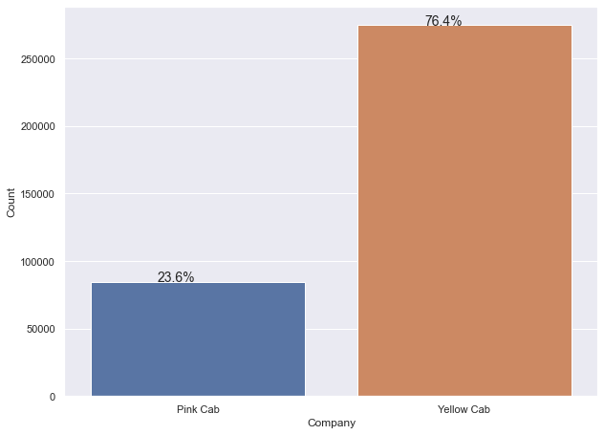
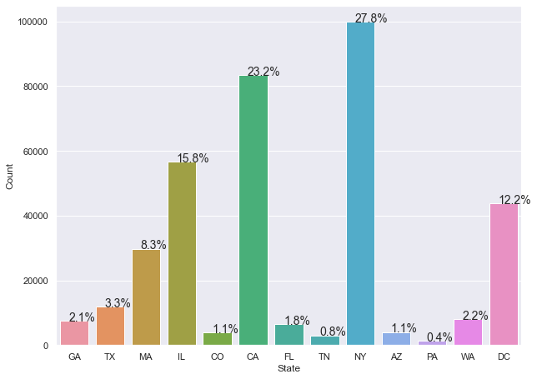
Exploratory Data Analysis
Company
State
Yellow cab seems to have much larger share of the taxi market.
One explanation could be that pink cabs are more expensive and are tailored for higher income audience. We will have to check this later.
New York followed by California have the highest number of taxi trips.
Illinois and Washington DC are third and fourth respectively with 15.8% and 12.2% of the market share.

Slide 6
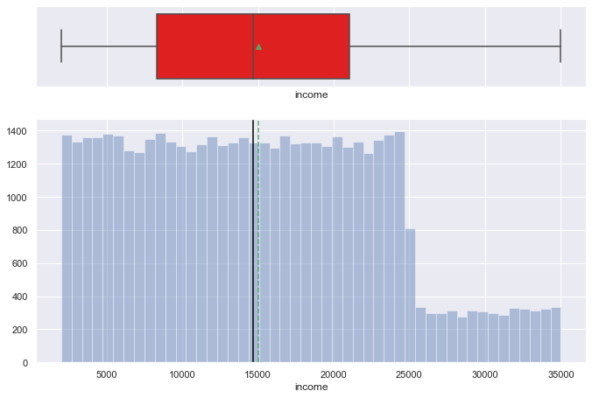
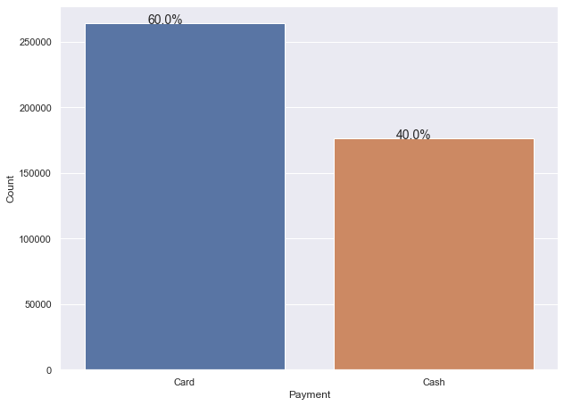
Exploratory Data Analysis
Company
State
Similar to age, the income distribution is also uniform and divided into two parts, with the change in frequency occurring at $25000.
All incomes before $25000 has a frequency of around 1400 customers, while an average of 300 to 400 customers have incomes more than 25000.
More people tend to pay with card than cash

Slide 7
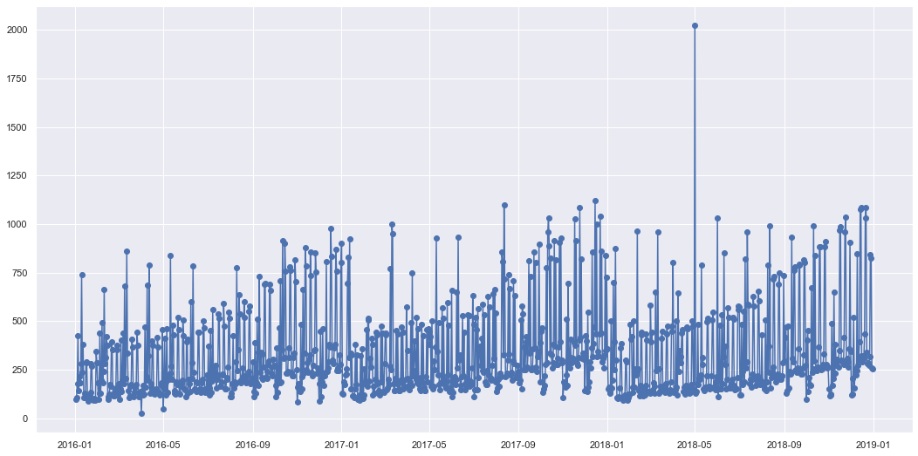
Hypothesis 1
H0: mean trips of each quarter is the same. H1: at least one pair of quarters have different mean trips. This hypothesis will check to see if there is any seasonality or trend in the taxi trips per year - if the trips in each quarter are generally the same or different.
Observations
On a holistic picture, it does seem that there is a general trend over the 3 years. There seems to be a massive spike in trips somewhere in the middle of 2018. Overall, there is no doubt that there is a seasonality trend.

Slide 8
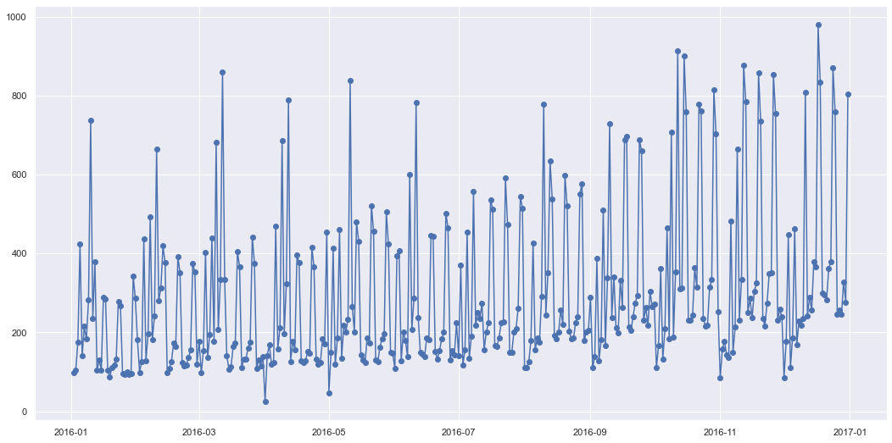
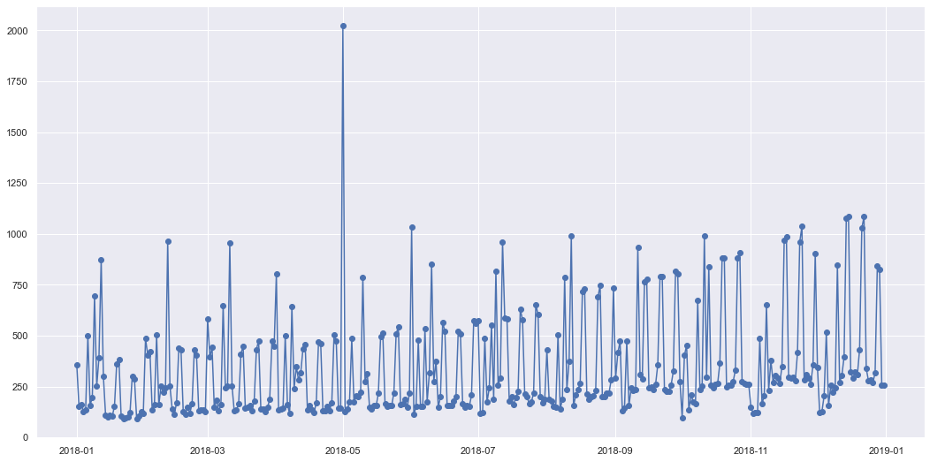
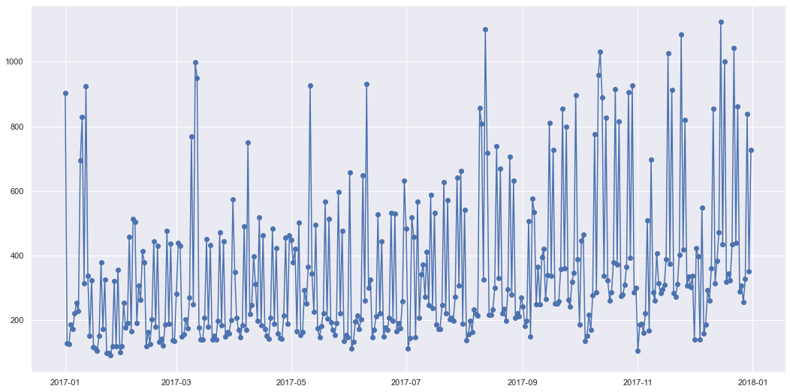
Hypothesis 1
2016
2018
2017

Slide 9
Hypothesis 1 - Results
Observations
The 3 years are very similar as noted previously.
Across the span of each year, the trips very gradually increases.
In each month, there also seems to be a trend.
Results
The graphs clearly indicate that there is seasonality in the taxi rides, and that the number increases gradually throughout the year, and then drops at the start of the year (except for New Year)
Thus, H0 is rejected.

Slide 10
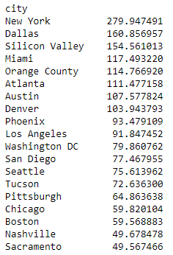
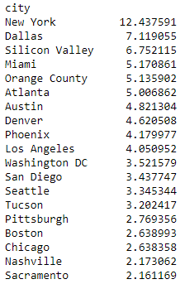
Hypothesis 2
H0: average profit margin of each city is the same. H1: average profit margins are different for at least one pair of cities. This hypothesis will check if the average profit margins are the same from city to city.
Average Profit
Profit / km
Results
Straight away we see that the mean profit for each city is quite different. In New York it is extremely high. Other prominent cities such as Silicon Valley, Orange County and Miami also have profit margins on the higher side.
The range of means is also quite large, even without considering New York.
Based on what we have seen, we can safely say that the profit margins are not the same for each city.
The null hypothesis is rejected

Slide 11
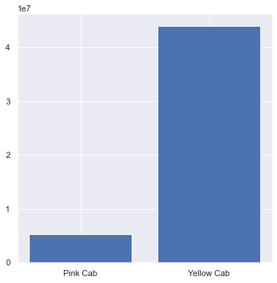
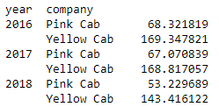

Hypothesis 3
H0: average profits for yellow cab is different to that of pink cab. H1: average profits for both companies are different. This hypothesis will check if the profit margins are different for each company.
Results
This shows that yellow cab has made much more profit over the 3 year period than pink cab, almost $38m more.
The average profit is also higher, so yellow cab seems to charge more than pink cab.
But in 2019, both companies' profits seem to slightly lower than the previous 2 years, as shown in the result annual profit chart.
Therefore, we can say that the profits of both companies are not the same. So this hypothesis is also rejected.
Total Profit per company
Average Profit per company per year
Average Profit per company

Slide 12
Hypothesis 4
H0: mean income of customers is different for each company.
H1: mean income is different for each company.
This hypothesis will check if the taxi companies cater to different income groups of customers or not.
Results
The first step was to check if customers use both companies or not. If they use both, then it would not help in this analysis since there will be a lot of overlapping.
However, it was found that more than 25000 customers used both Pink and Yellow taxi services, therefore this hypothesis was not continued.

Slide 13
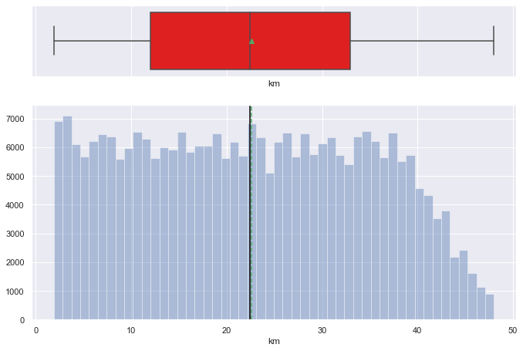
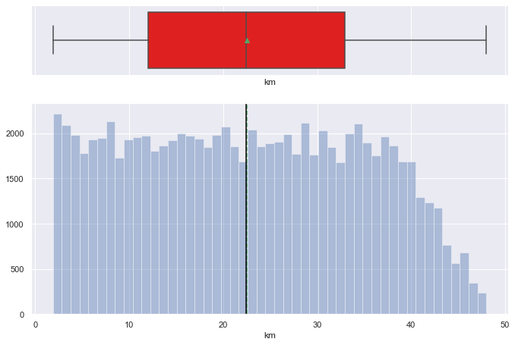
Hypothesis 5
H0: mean km of both companies are same.
H1: mean kms of both companies are different.
Since customers tend to use both companies, let's check if the distance travelled has an effect on choice of cab.
Total kms - Yellow Cab
Total kms – Pink Cab

Slide 14
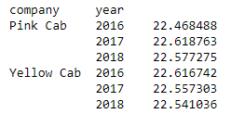
Hypothesis 5
Average km
Results
The histograms are also very similar for both companies, just that yellow cabs have much more trips than pink cab.
The average kms travelled is almost the same for each company, and also same per year.
The means are obviously almost the same, so we fail to reject the null hypothesis.

Slide 15
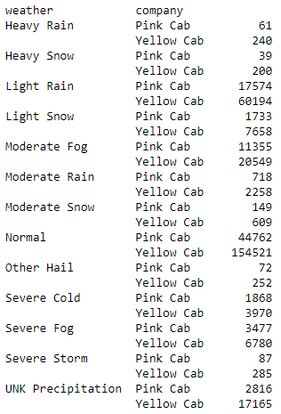
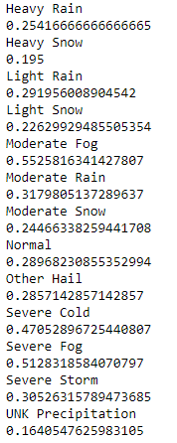
Hypothesis 6
H0: trips in each weather type are same for both companies compared to normal conditions
H1: trips are affected by weather for one company differently than for the other company.
We will check if customers prefer a certain type of cab based on the weather.
Count
Ratio of pink to yellow cabs
Results
So the ratio of pink to yellow cabs used during normal weahter is around 0.29. The ratios during other weather conditions also are around the same range, between 0.25 to 0.31, except for a few conditions.
Among the exceptions are moderate fog, severe fog and severe cold, where the ratio is almost 0.5 for both. This almost feels like due to the conditions, the customers just wanted a cab and were willing to take whatever company's taxi was available.
This theory is not evident in the case of severe storm or heavy rain, however.
Due to the few weather conditions that showed a large increase in use of pink taxis, which increased the ratio in question, we can say that the null hypothesis is rejected, and that some weather conditions do affect the customers' choice of cab.

Slide 16
Recommendations
The recommendation after all the analyses and hypotheses is that XYZ firm should invest in the Yellow Cab company.
The reasons are as follows:
The market share is dominated by Yellow cab, with around 76%.
It has much higher profits than pink cab over the 3 years of data, regardless of the km travelled, time of year, customers etc.
It has customers of all backgrounds and income groups. Regardless of their higher prices, customers still seem to flock to Yellow cab's services rather than pink cab.
From the analyses conducted here, there has been no clear indicator as to why the high prices are not deterring the customers away. The only explanation would be that the quality of service is far better from Yellow Cab, that customers do not mind paying a bit more.

Slide 17
Further Insights
Majority of customers are below 40 years and have income of 25000 and below.
The gender of customers is fairly equally distributed.
New York has the majority of taxi trips, unsurprisingly. It also has the highest profit margins.
The taxi trips tend to increase gradually over the year, and then fall back slightly as the new year begins.
New Year's day generally has a spike in taxi trip.

Slide 18
Thank You

